Slide 1
Planning and Planting Your Fall Vegetable Garden
Wednesday@WillRogers
Oklahoma County Master Gardeners
July 14, 2021

Slide 2
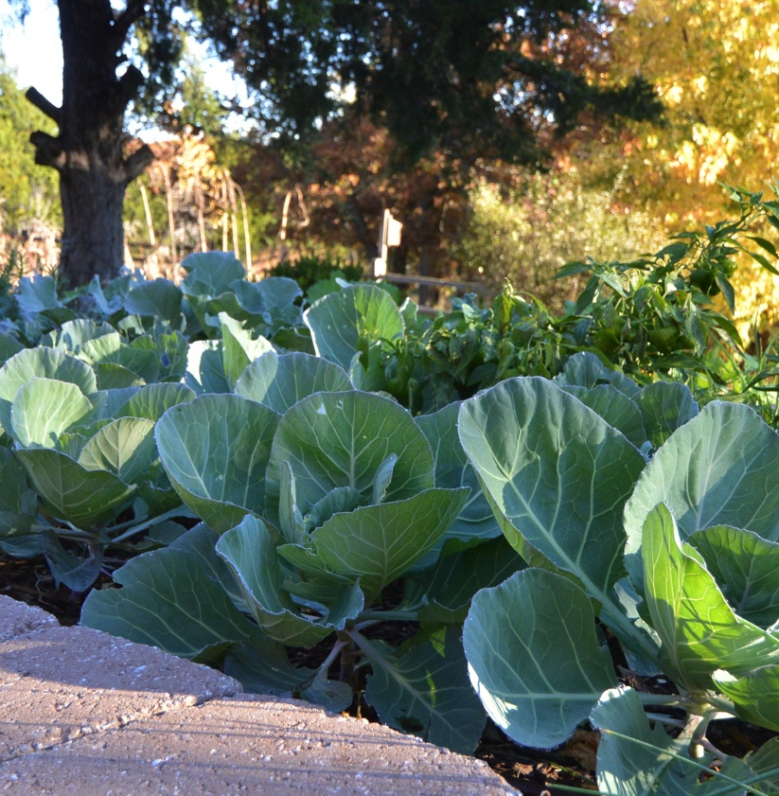
Fall Gardening 101
Central Oklahoma has a long growing season
You can plant and harvest more than one time per year
Fall garden planning (and planting) starts earlier than you think – like now!

Slide 3
Fall Gardening 101
We will talk about:
  Conditions and challenges in fall gardening
  Temperature, sunlight, and moisture
  Growing times and days to harvest
  Germination issues
  Recommended plants for fall veggies
  How to choose good varieties for fall gardening

Slide 4
Fall Gardening - Conditions
The number of days in the second half of our growing season in central Oklahoma exceeds the days in the spring-to-summer season.
Average last spring frost – April 15
Average first fall frost – November 1
Days from April 15 – July 15 = 91 days
Days from July 15 – November 1 = 105 days

Slide 5
Fall Gardening - Conditions
There are approximately two more weeks of frost-free dates *on average* in the second part of the season
You will need those two weeks due to the Fall Factor
When calculating days to harvest in the fall garden, you should add 7-10 days to the estimates for each plant due to changing conditions into fall

Slide 6
Fall Gardening - Conditions
Good soil prep is important for any kind of vegetable crop, but it is VITAL for producing good seedlings and transplants in the heat of summer
Good soil should have plenty of compost and other organics worked in, be free-draining but able to retain moisture, and rich enough to feed the littles as they grow
Compost is the answer to most soil issues

Slide 7
Fall Gardening - Conditions
The three biggest climatic conditions and challenges to keep in mind for starting the fall garden:
  High heat and soil temperature
  High sunlight intensity
  Rapid drying of the soil
These begin to change after the end of August or so, but will be prevalent in July and August

Slide 8
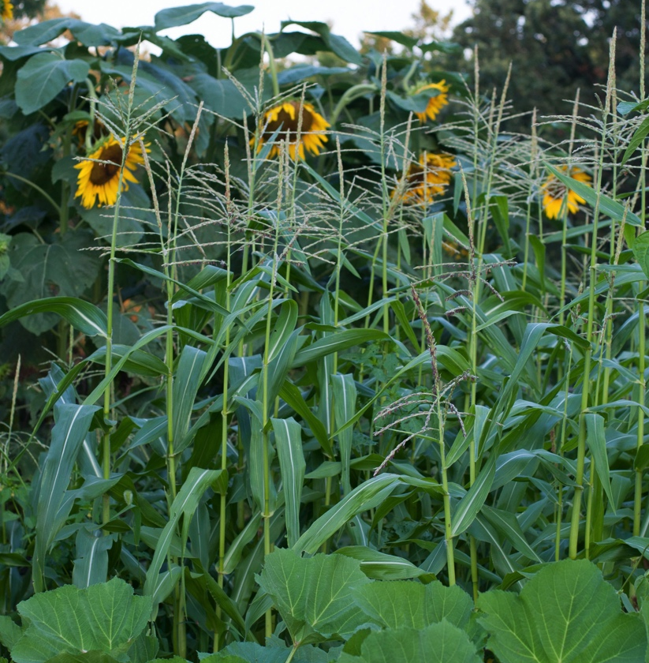
Fall Gardening - Conditions
As the summer goes on, the days get shorter (fewer hours of sunlight), the sun angle moves towards the south, and the heat tends to abate

Slide 9
Fall Gardening - Conditions
The changes in the amount, angle, and quality of daylight must be taken into consideration
Look at your garden beds or where you plan to grow, and make sure you understand that some things that get full sun in July may be in shade by late September
Not always a problem, but be aware

Slide 10
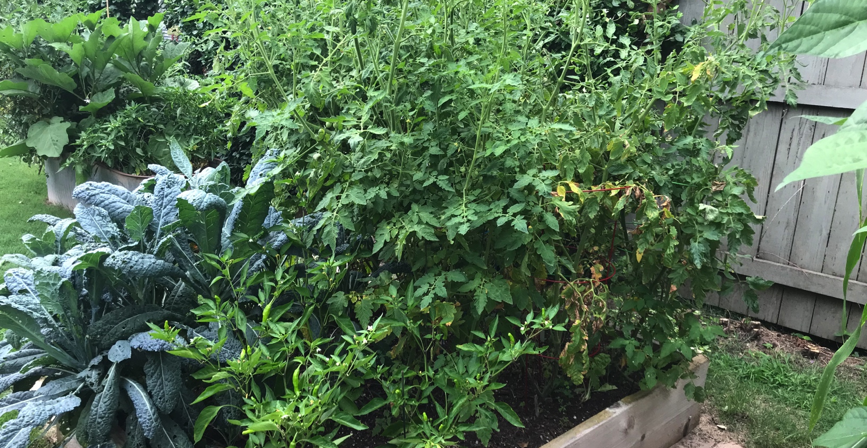
Fall Gardening - Conditions

Slide 11
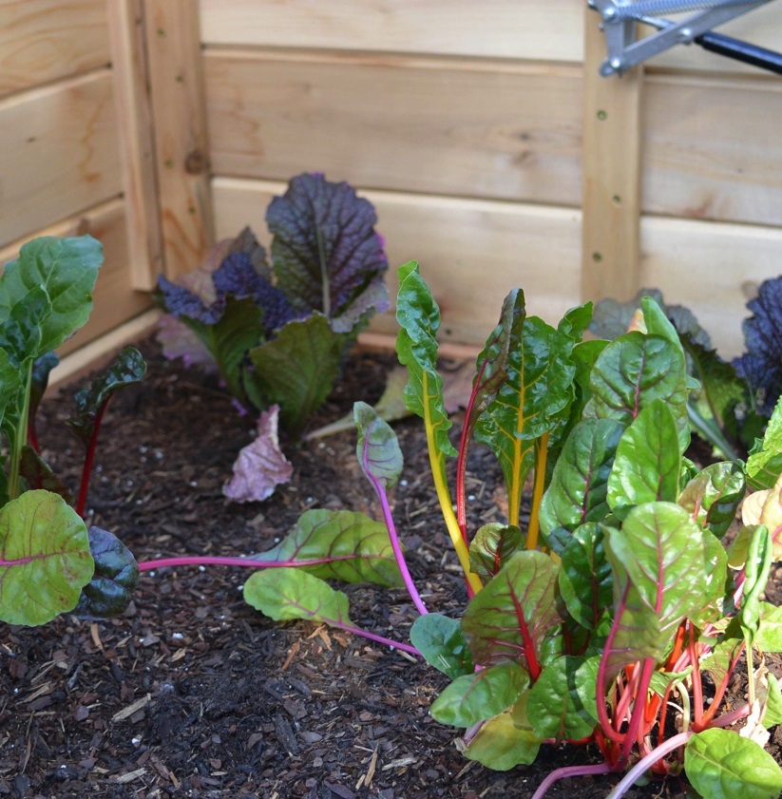
Fall Gardening - Conditions
Harsh summer conditions can be managed by using the usual measures like mulching and frequent watering
Grow seedlings in a cool, shady spot in summer heat

Slide 12
Fall Gardening - Conditions
Shade structures or shade cloth draped over supports can give baby plants a more comfortable environment in the heat
Plain or fancy - use what you have, buy something new or build something custom
Portable is good for small shade areas
Move containers to shaded areas

Slide 13
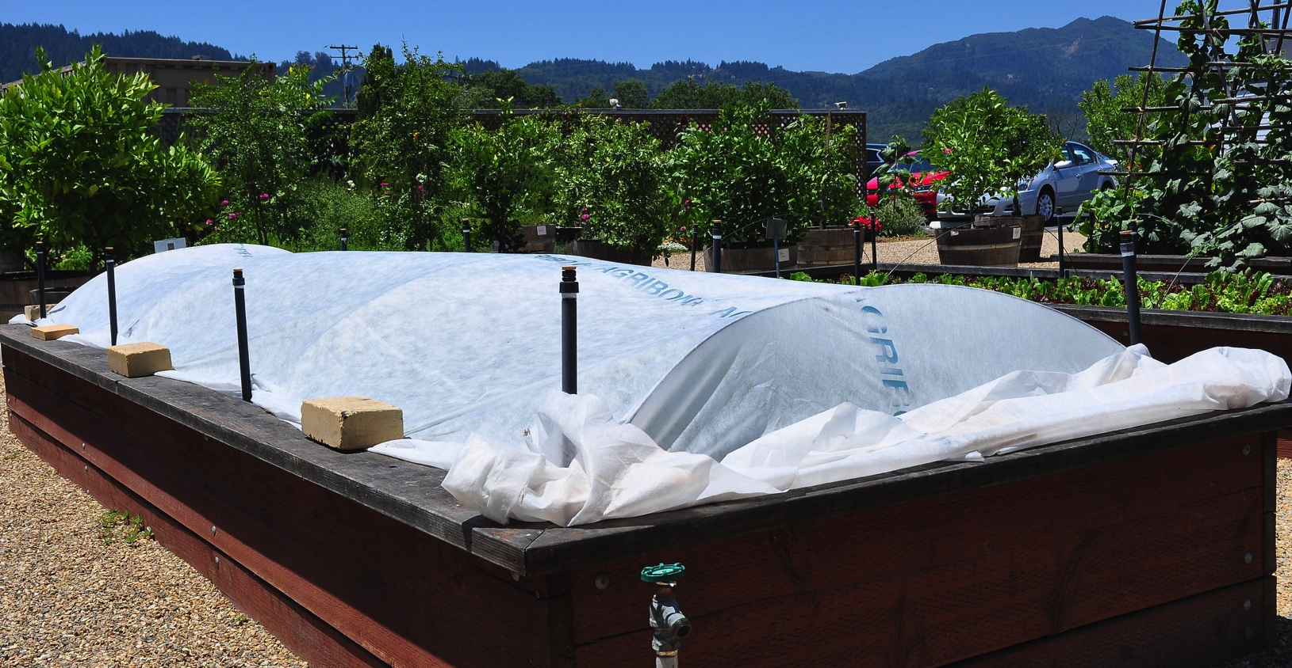
Fall Gardening - Conditions

Slide 14
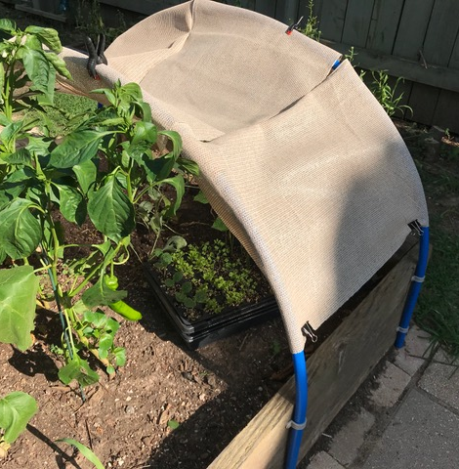
Fall Gardening - Conditions
The same supports used for winter freeze cover can hold shade cloth in the summer
If you can, make it so you can remove it easily when you want full sun later

Slide 15
Fall Gardening - Conditions
Getting enough water to your baby plants and seedlings is very important – plan to water everyday when it is hot and not raining regularly
Drip irrigation can save a lot of work
Water the specific plants and rows, rather than sprinkling everything to conserve water

Slide 16
Fall Gardening - Conditions
You can soak your seeds in water for a few hours to overnight before planting to give them a boost (do not do this for beans and peas)
Pre-water deeply in the beds or containers you are using to plant in
Mulch after seedlings sprout or plants are put in the ground to conserve moisture and cool soil

Slide 17
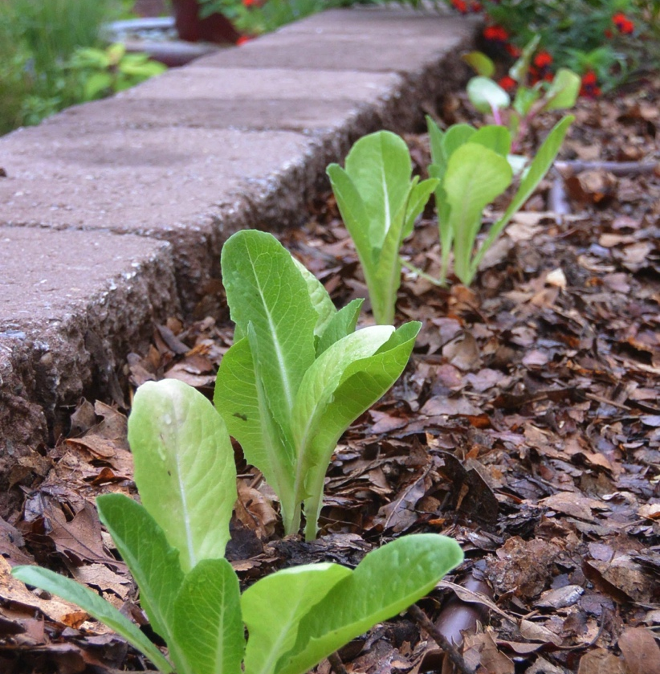
Fall Gardening - Conditions
You can alter some of the planting depths, but not by much
Adding mulch after sowing seeds is better than planting too deep for that plant

Slide 18
Fall Gardening - Conditions
Weed control is very important when growing transplants or sowing seeds in summer
Mulch early and fairly heavily
Cultivate/hoe weeds when they are small
Pull weeds carefully so as not to disturb the soil around new plants and seedlings
Weeds slow down as the days get shorter

Slide 19
Fall Gardening - Conditions
Some vegetables are better grown from transplants, others from direct sowing of seeds
Seed starting in summer is very different from early spring – much faster sprouting!
Biggest issue is keeping the seedlings watered and shaded
Cool season crops like lettuce germinate best when it’s cooler

Slide 20
Seed Starting for Fall
From now (mid-July), for the next few weeks plants can be started from seed for transplanting into the garden later
Can be started indoors (with adequate light) or outdoors (with adequate shade)
This can be important as it may be hard to find commercial transplants in August and September
Keep asking your nursery to stock fall veg!

Slide 21
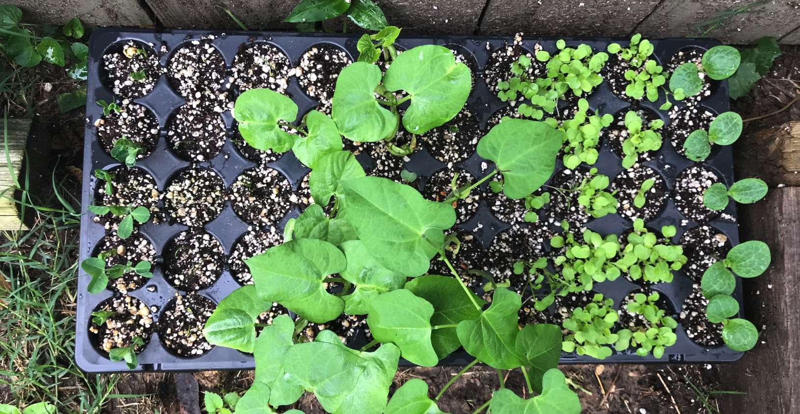
Seed Starting for Fall

Slide 22
Fall Vegetables to try
Sweet corn – sow seed directly in the ground RIGHT NOW for a fall crop
Look on seed packet for Days to Harvest
Usually 80-100 days
Don’t forget to add another 7-10 days for the Fall Factor (lessening heat, daylight and hours of sun)
Sow in cleared area, or interplant among an existing summer crop

Slide 23
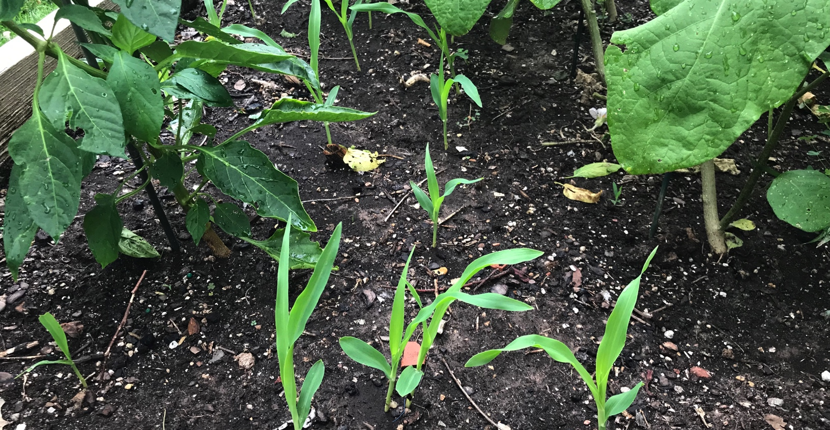
Interplanting/Intercropping

Slide 24
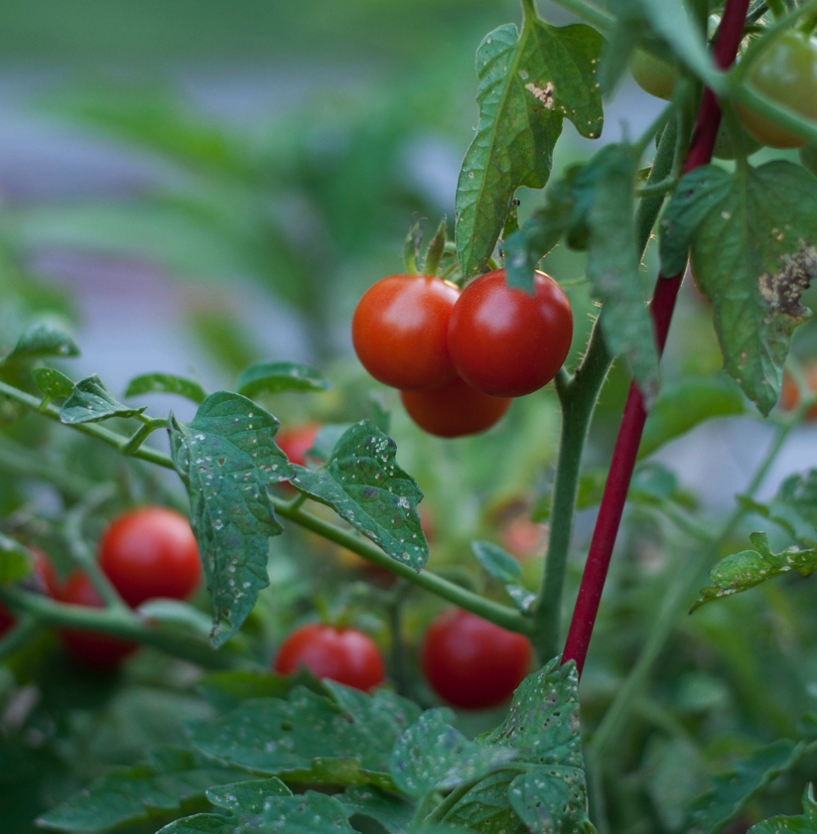
Fall Vegetables to try
Tomatoes / Peppers / Eggplant – all “warm season” veggies
These frequently need lots of warmth and sunlight to mature (especially peppers)
Most of these in the nightshade family need 90-110 days to harvest

Slide 25
Fall Vegetables to try
Squash – summer and winter (summer squashes mature faster), incl. Pumpkins
Can be direct sown or transplanted
Transplants need to be started a month or so before planting into the garden
Check Days to Harvest for your varieties
Be vigilant about controlling for squash bugs and other pests

Slide 26
Fall Vegetables to try
Green beans – bush varieties are good for fall gardening
Plant from seed or transplants
Many bush-type green beans take only 50-60 days to mature (some beans take much longer – check the Days to Harvest)
Can plant in succession to prolong harvest (if you have the space)

Slide 27
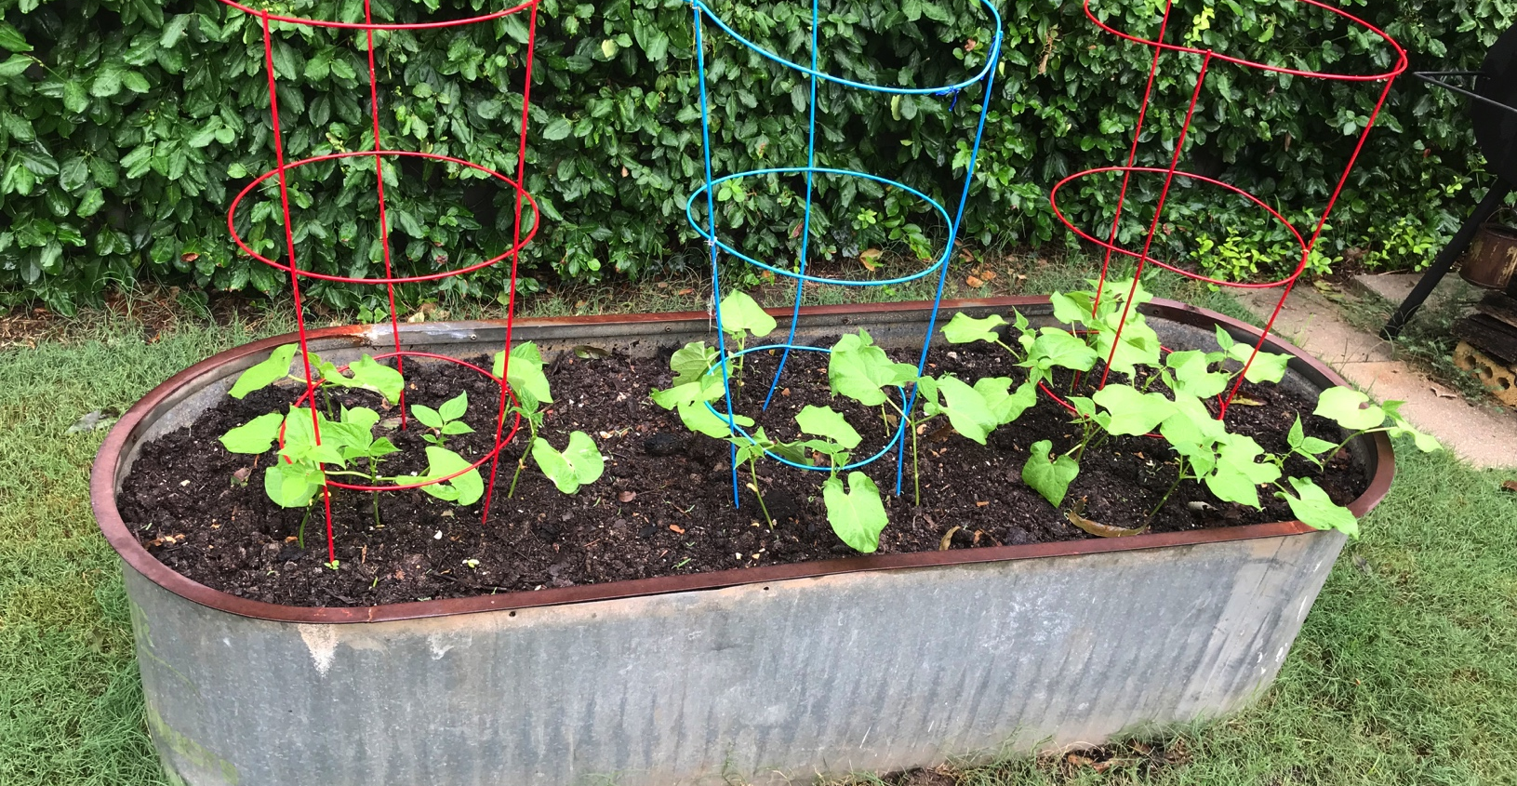
Fall vegetables to try

Slide 28
Fall Vegetables to try
Cool season cruciferous veggies such as broccoli and Brussels sprouts should be started in seed trays in early July (now is fine, too)
Transplant as soon as the plants are sturdy enough to take the conditions (a month or two after sowing)
These can take colder temps and light frosts in late autumn

Slide 29
Fall Vegetables to try
Carrots are a possibility for fall gardens
Must be direct sown and kept cool and shaded; loose, sandy soil is best
Seeds are miniscule and planting depth is very shallow, so watch heat and moisture carefully
Some varieties are better than others for fall gardens

Slide 30
Vegetables to try
Cabbage, collards and cauliflower can be transplanted into the garden in August, after the heat starts to lessen a bit
Sow seed trays now to grow transplants for next month’s planting
These veggies love a bit of cool weather and can be harvested into November most years

Slide 31
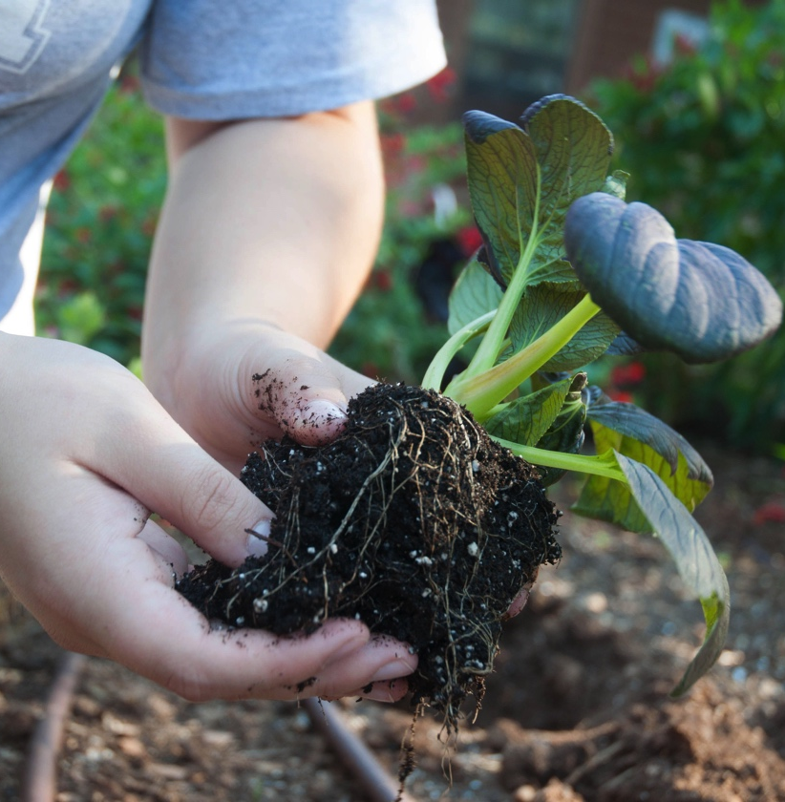
Fall Vegetables to try
Asian greens – Chinese cabbage and broccoli, baby Bok Choy, Tatsoi, Mizuna, Japanese mustard, and lots of others are great in the fall garden, and can be harvested well into winter with just a bit of protection

Slide 32
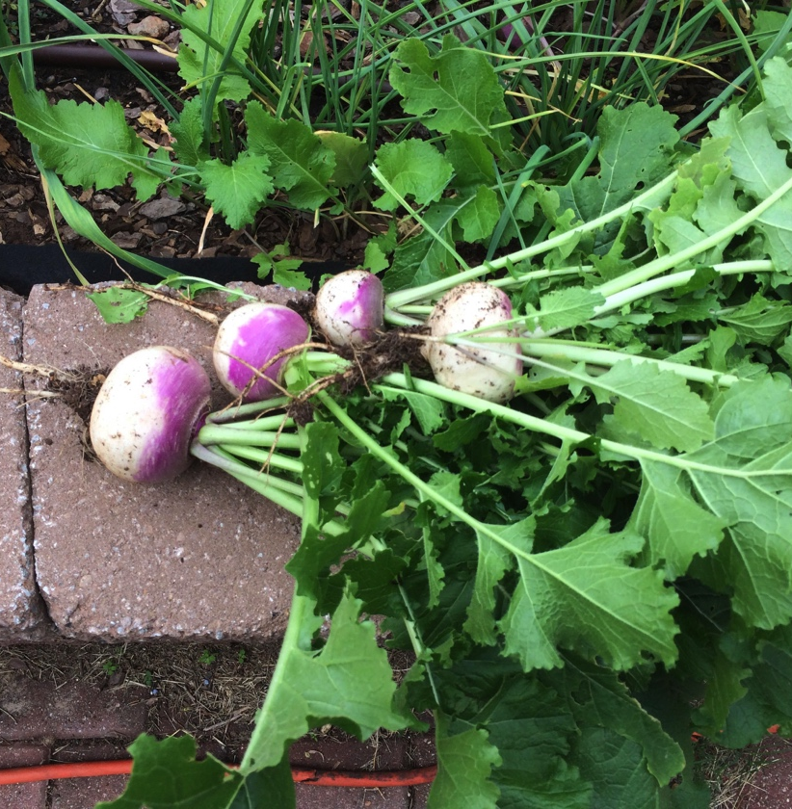
Fall Vegetables to try
Turnips are good in the fall – sow seeds in August through mid-September
50-60 Days to Harvest for most varieties
Succession planting works well

Slide 33
Fall vegetables to try
Green peas can work in the fall but they don’t really like heat
Pick faster-maturing varieties (60 days or so) for best results
Plant seeds directly in late August and early September

Slide 34
Fall Vegetables to try
Leeks, onions and garlic are great fall/winter crops
Start leeks in seed trays now for transplanting in a few weeks
Onions can be grown from seed, sets or plants (sets are great but may be hard to find in fall)
Plant garlic in late September, harvest next June
Harvest onions and leeks next spring

Slide 35
Fall Vegetables to try
Kale – all varieties – are wonderful fall garden vegetables
Some, like Lacinato (aka Tuscan, Nero, Dinosaur kale), can survive the winter and give you fresh leaves for harvesting all autumn long and again the next spring
Sow seeds directly in the ground in September onwards

Slide 36
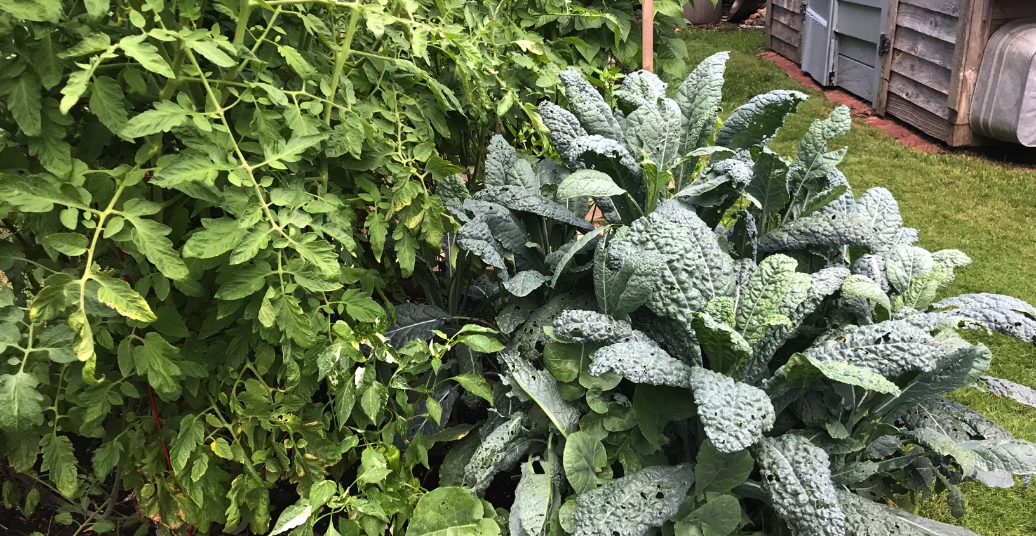
Fall vegetables to try

Slide 37
Fall vegetables to try
Swiss chard and spinach are good in the fall; don’t mind a little cold
Chard can take a bit more heat
Spinach likes cool weather generally and will bolt (go to seed) quickly if it’s too warm
Sow chard seeds in August and September; spinach seeds in later Sept.

Slide 38
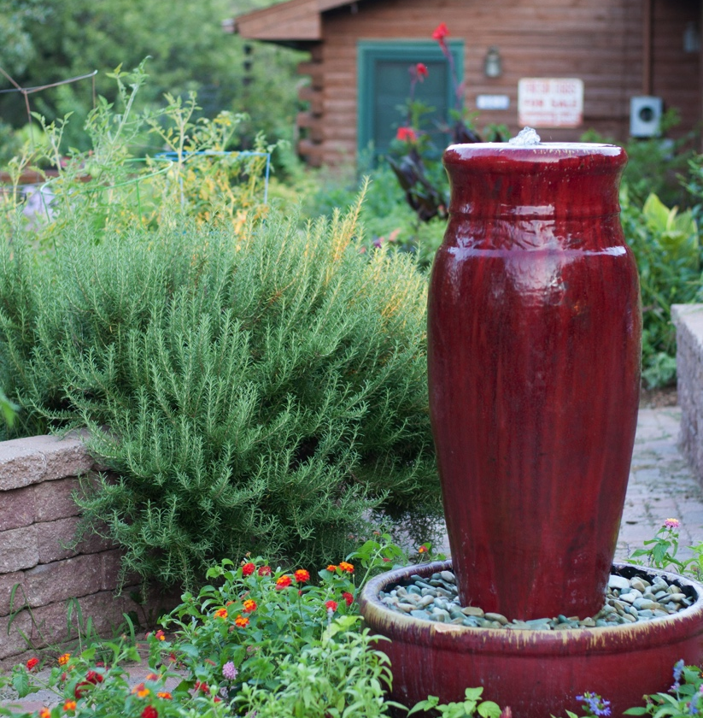
Herbs for Fall
Direct sow seeds for basil, cilantro, chervil, dill, lemon balm, oregano, parsley, and other tender herbs all summer long
Thyme, rosemary in containers or protected areas

Slide 39
Tips on Selecting Veggies
Because it is more difficult to find plants for fall, access to a good seed catalog (or many catalogs) can be very helpful in selecting which varieties to try
Save your catalogs from last spring
Read the descriptions carefully, check Days to Harvest and other information
Examples

Slide 40
Wednesday @ Will Rogers
No W@W Program in August
We will return on September 8th
and October 6th
***

Slide 41
Fall Gardening
Best of luck with your fall growing adventures!
Call 405 713-1125 during weekdays to Ask A Master Gardener
@okiemgs – follow us on Twitter and Like us on Facebook
Photo credits – Dee Nash @reddirtramblings and Karen Collier

